Slide 1
Car Price Prediction Project
Submitted By:
Chandan Kumar

Slide 2
OUTLINE
Introduction
Problem Statement
Project Specification
Dataset
Pipeline
Data Cleaning
Feature Engineering
Model Creation
Result/Output

Slide 3
1. Introduction
Vehicle price prediction especially when the vehicle is used and not coming direct from the factory, isboth a critical and important task. With increase in demand for used cars more and more vehicle buyersare finding alternatives of buying new cars.
There is a need of accurate price prediction mechanism for the used cars. Prediction techniques ofmachine learning can be helpful in this regard.
It is common to lease a car in many countries rather then buying a new car.

Slide 4
2. Problem Statement
The research objective of this study is to predict used cars prices using data mining techniques, by scraping data from websites that sell used cars, and analysing the different aspects and factors that lead to the actual used car price valuation.
To enable consumers to know the actual worth of their car or desired car, by simply providing the program with a set of attributes from the desired car to predict the car price.

Slide 5
3. Project Specification
This project aims to deliver price prediction models to the public, to help guide the individuals looking to buy or sell cars and to give them a better insight into the automotive sector.
Buying a used car from a dealer can be a frustrating and an unsatisfying experience as some dealers are known to deploy deceitful sale tactics to close a deal. Therefore, to help consumers avoid falling victims to such tactics.
Another goal of the project is to explore new methods to evaluate used cars prices and to compare their accuracies.
Considering this is an interesting research topic in the research community, and in continuing their footsteps, we hope to achieve significant results using more advanced methods of previous work.
We are using Machine Learning algorithm to create a predicative model.
Multiple linear Regression algorithm is used to train and test the model in our project.
Import the data.

Slide 6
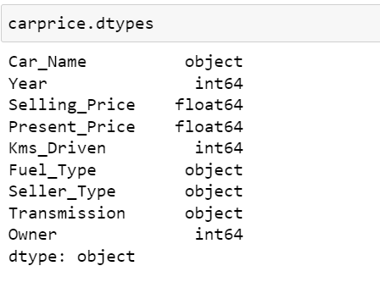
4. Dataset
Dataset comes from our organization.
There are 301 number of observations in our dataset .
The all 9 columns are available in our dataset.
We have used a total of 5 features to Car Price prediction dataset.

Slide 7
3. Pipeline
Data Cleaning
Features Engineering
Outlier Detection
Outlier Removal
Model Creation

Slide 8
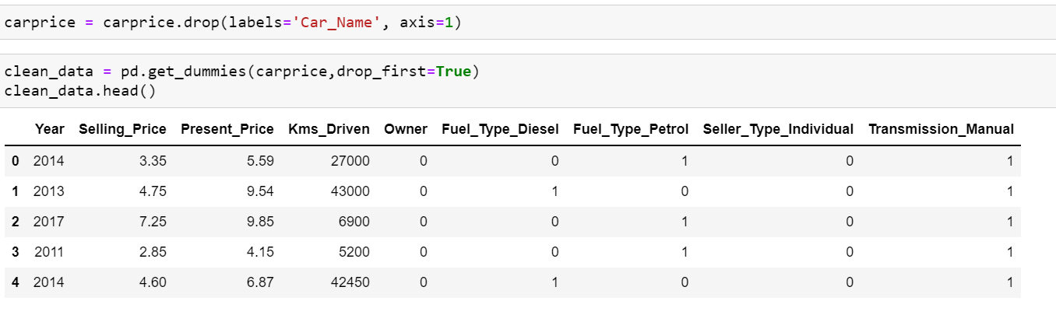
4. Data Cleaning
The main aim of Data Cleaning is to identify and remove errors & duplicate data, in order to create a reliable dataset.
The process of data cleaning is done by using a very famous library Pandas.
Initially , those columns/ features are dropped from our dataset who are not important in deciding the predict the car price.
The rows having a null value in any columns are dropped from our dataset.
The columns having characters as well as integer values are converted into integer value only.
Many more data cleaning techniques are used to improve the quality of our dataset.

Slide 9
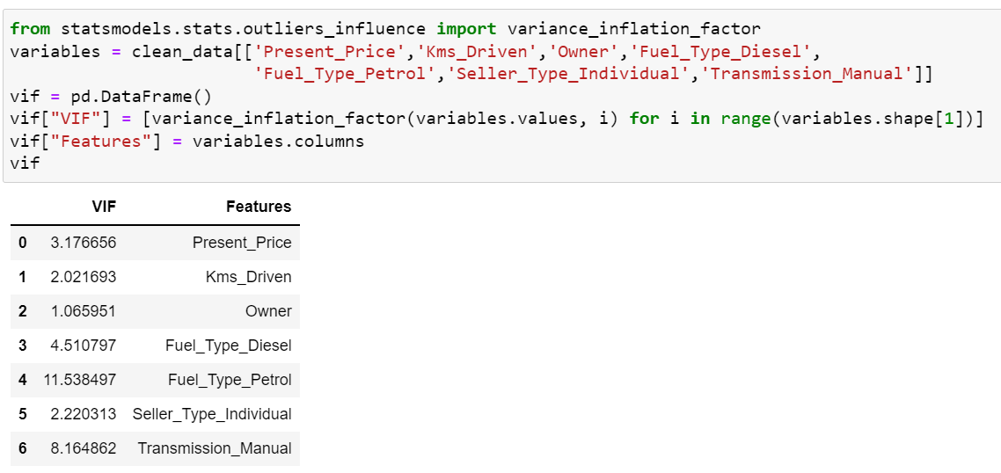
7. Feature Engineering
As we have already made the caprice with all the categorical features so we will drop all those feature consisting categorical variable from original data frame and at the end after using feature engineering in caprice we will concatenate caprice with original data frame and by doing this we will be able to convert all the variables into numerical form.

Slide 10
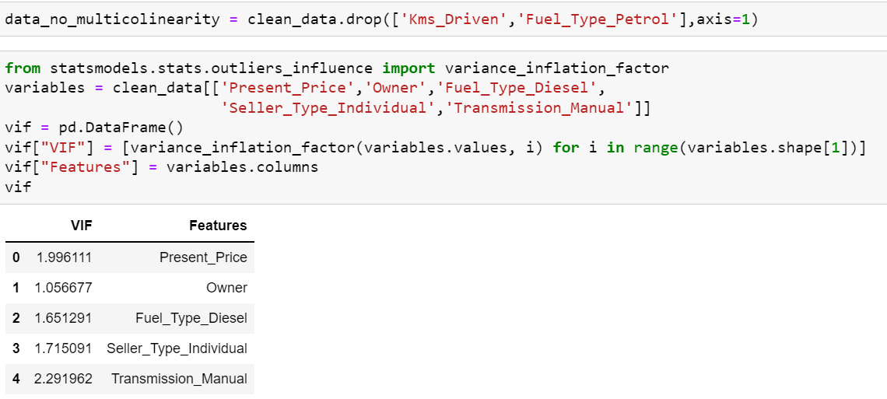

Slide 11
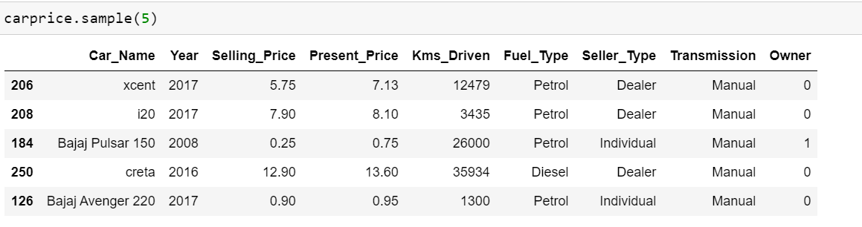
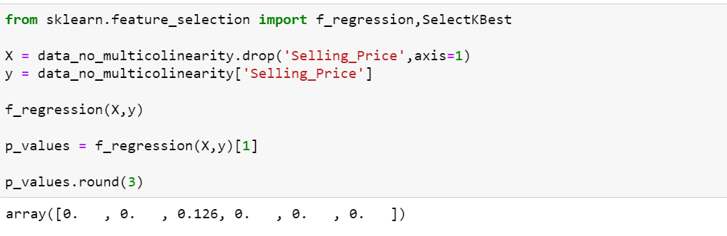

Slide 12
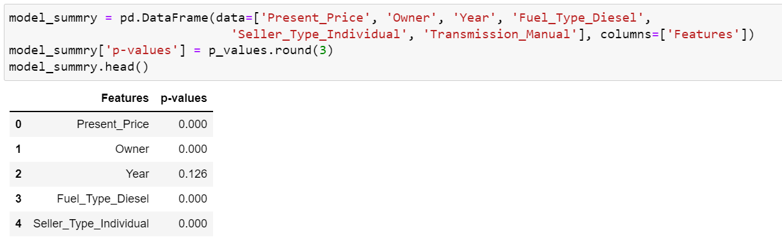
8.Model Creation
The process of modeling means training a machine learning algorithm to predict the labels from the features.
We have used Linear Regression algorithm for training and testing of the model.
The accuracy rate of our model is pretty good.

Slide 13
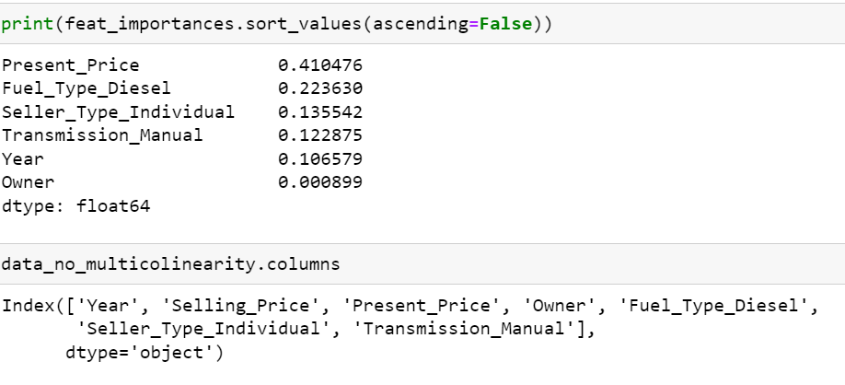
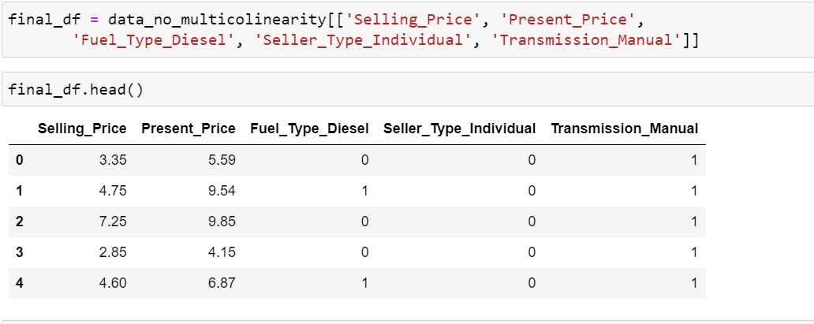

Slide 14
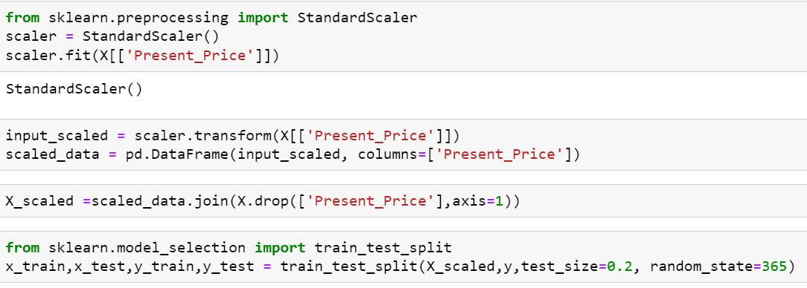
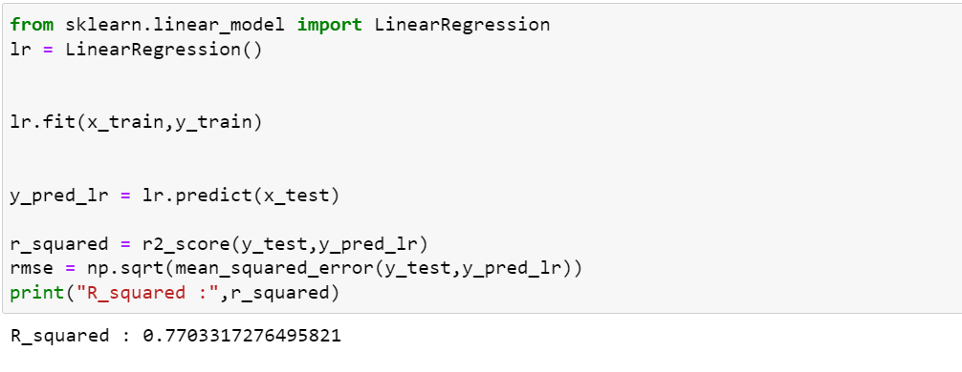

Slide 15
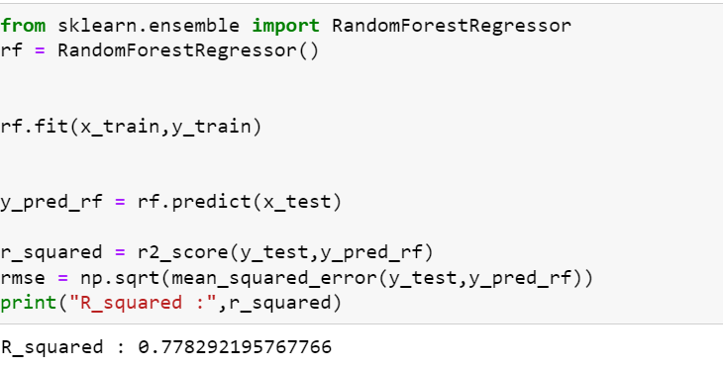
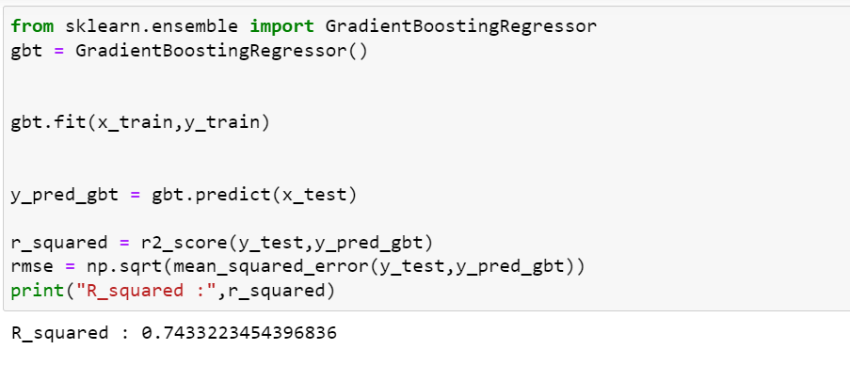

Slide 16
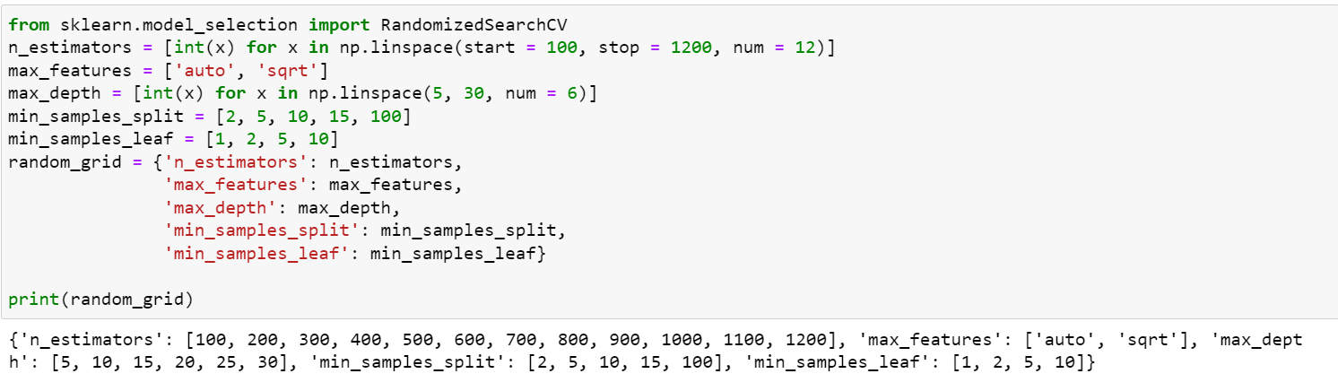

Slide 17
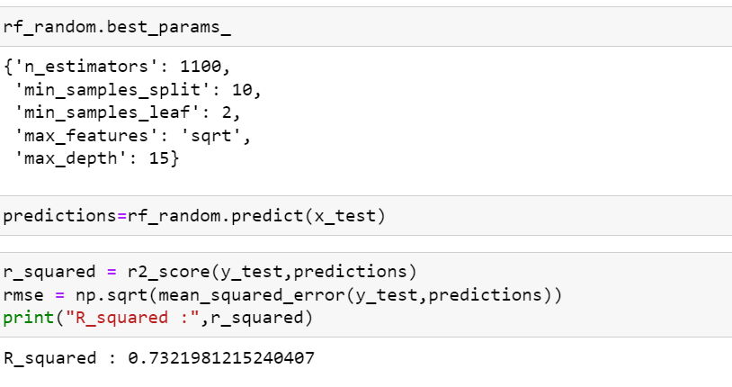

Slide 18
9.Result/Output
We created a function to predict the car price .
Our function be like “ Predict Price Car_Name, Year, Selling_Price, Present_Price, Kms_Driven etc”.
When we pass the values into our function, It will predict car priceto us.

